Slide 1
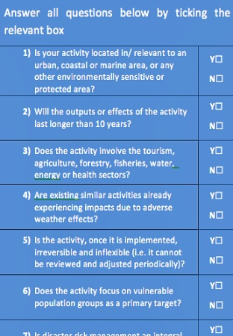
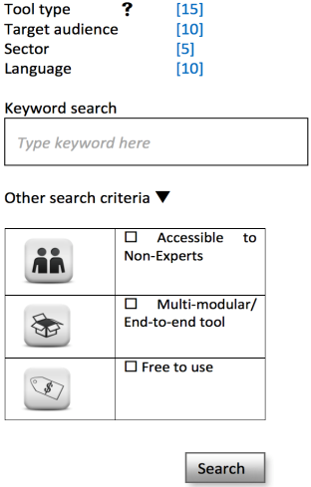
CCORAL – Delivering climate resilient development
Enter CCORAL: select country/entire region
Screening exercise
Understanding climate influence on decisions: Expert (E)
End-to-end CRM processes
Toolbox:
70+ CRM tools
◻ Legislation
◻ National planning
◻ Strategy or policy
◻ Programme or project
Budget prep /evaluation.
Understanding climate influence on decisions: Non-Expert (NE)
Information and links to data relevant to your country of interest and the Caribbean.
Quick identification of whether your activity is climate- influenced, and a priority for further assessment.
Guidance on how and why climate is relevant and can be integrated into the decisions organisations make. Information tailored to the experience of the user.
Guidance on undertaking a complete climate risk management (CRM) process.
A searchable toolbox to find the most appropriate tools to support your project and experience.
2 minutes
5 minutes
E:15 mins; NE:1 hour
15 minutes
20 minutes

